Slide 1

Team Project
Nellimarla Saikiran Rao
Asha Nagireddy

Slide 2
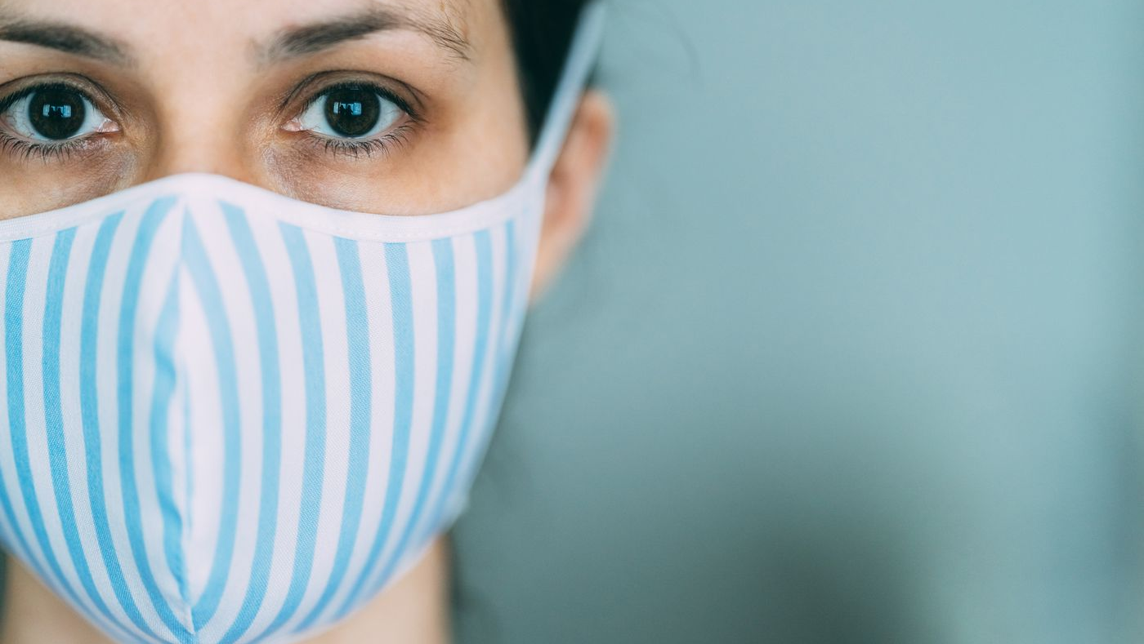
Project Topic
Face Mask Detection

Slide 3
Objective
In the era of the COVID-19 pandemic, it is important for individual to wear face masks to control the spread of virus.
Face mask detection project is intended to detect if a person in the image/video is wearing a face mask.
This technology can be used at airports to detect travelers without masks
Objective

Slide 4
Approach
Build the model using VGGNet
Extract face using ROI (Region of Interest)
Data Augmentation to increase efficiency
Tools
Keras
NumPy
Matplotlib
OpenCV

Slide 5
Keras VGGNet Model

Slide 6
Evaluation methodology
Cross Validation using test data
Evaluation using Webcam live.

Slide 7
Data Augmentation
Used to increase the efficiency by augmenting the dataset
Example of how an augmented dataset is like.

Slide 8
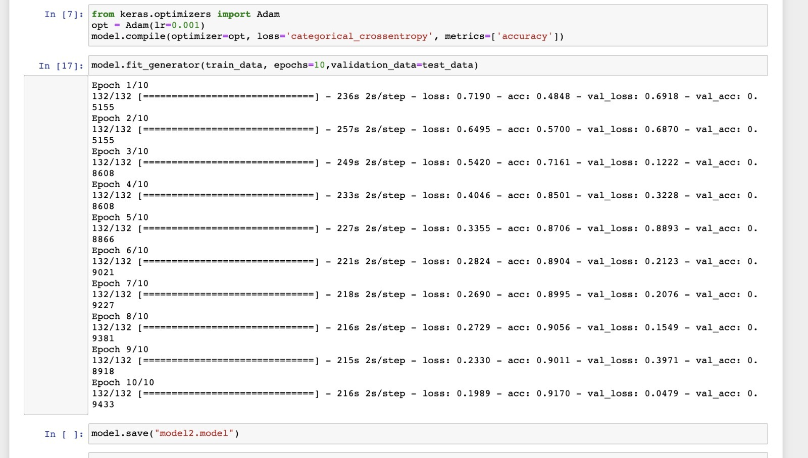
Cross validation using test data
Trained the model for SGD, RMSprop and Adam optimizers. Adam optimizer model produced highest accuracy of 94%.

Slide 9
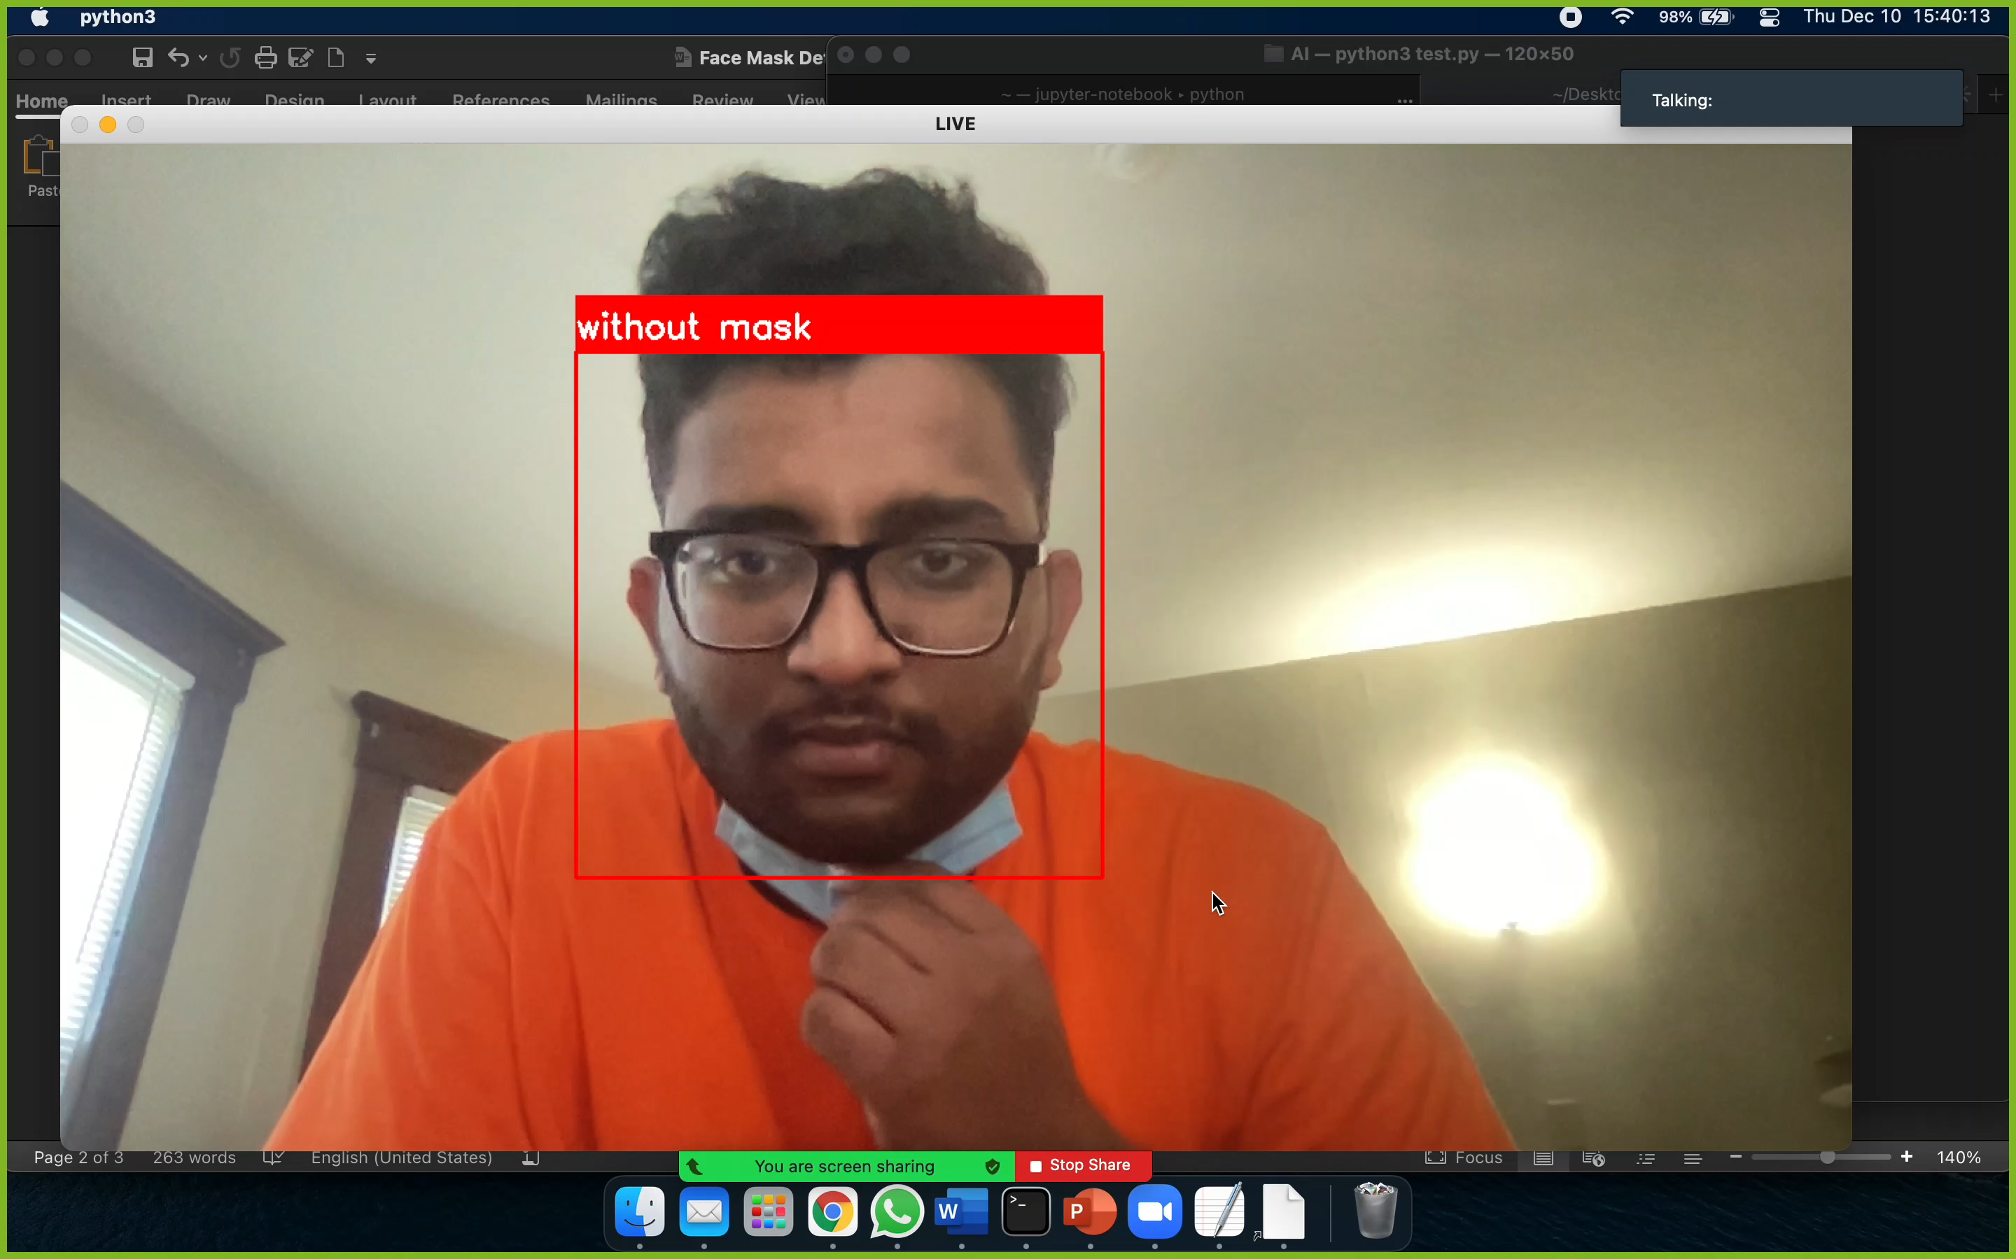
Evaluation using live Webcam…

Slide 10

THANK YOU

